Slide 1

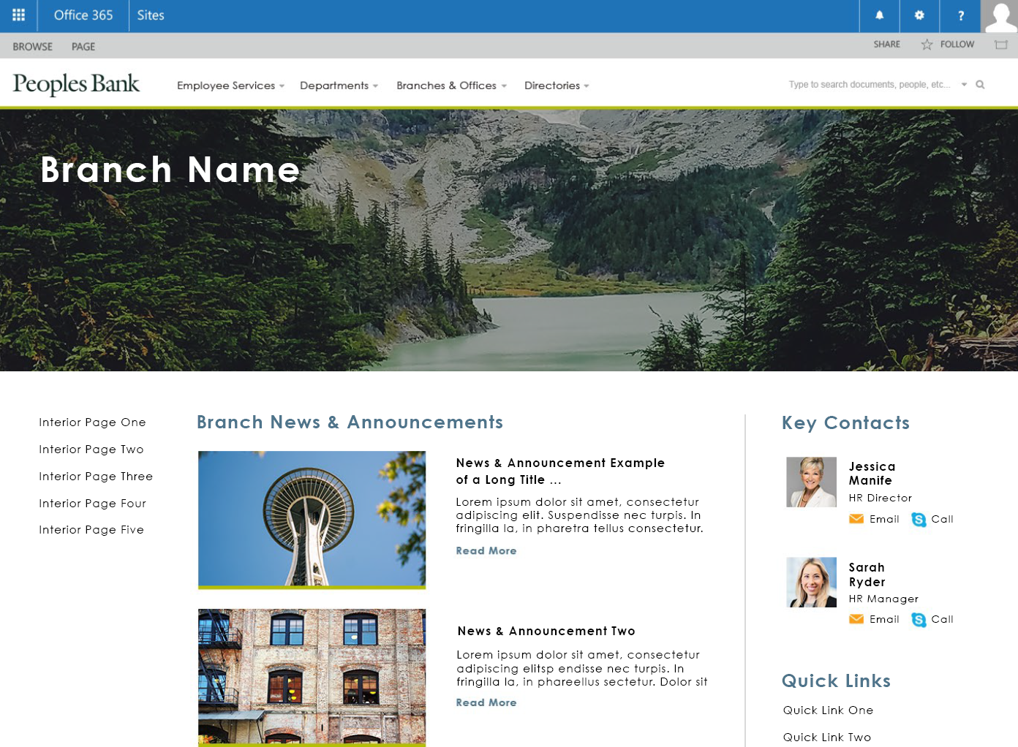
Peoples Bank – Corporate Intranet
Who They Are Peoples Bank is a bank in Washington State that strives to provide a high level of customer service to its members. Peoples provides personal and business banking, including an innovate mobile application to make mobile banking easy.
What Affirma Did
We helped Peoples Bank upgrade from SharePoint 2010 on-prem to SharePoint Online. The new site has a responsive visual design, a new information architecture and a user experience optimized for cross functional collaboration as well as departmental navigation.
We also conducted governance workshops and created a migration plan for their on-prem SharePoint environment and their shared network drive. A hybrid search configuration between SharePoint Server 2016 and SharePoint Online ended up being the best solution for Peoples Bank.
Content remains in a secured shared drive location and is surfaced through a search index hosted in a separate SharePoint Server 2016 environment.

Slide 2
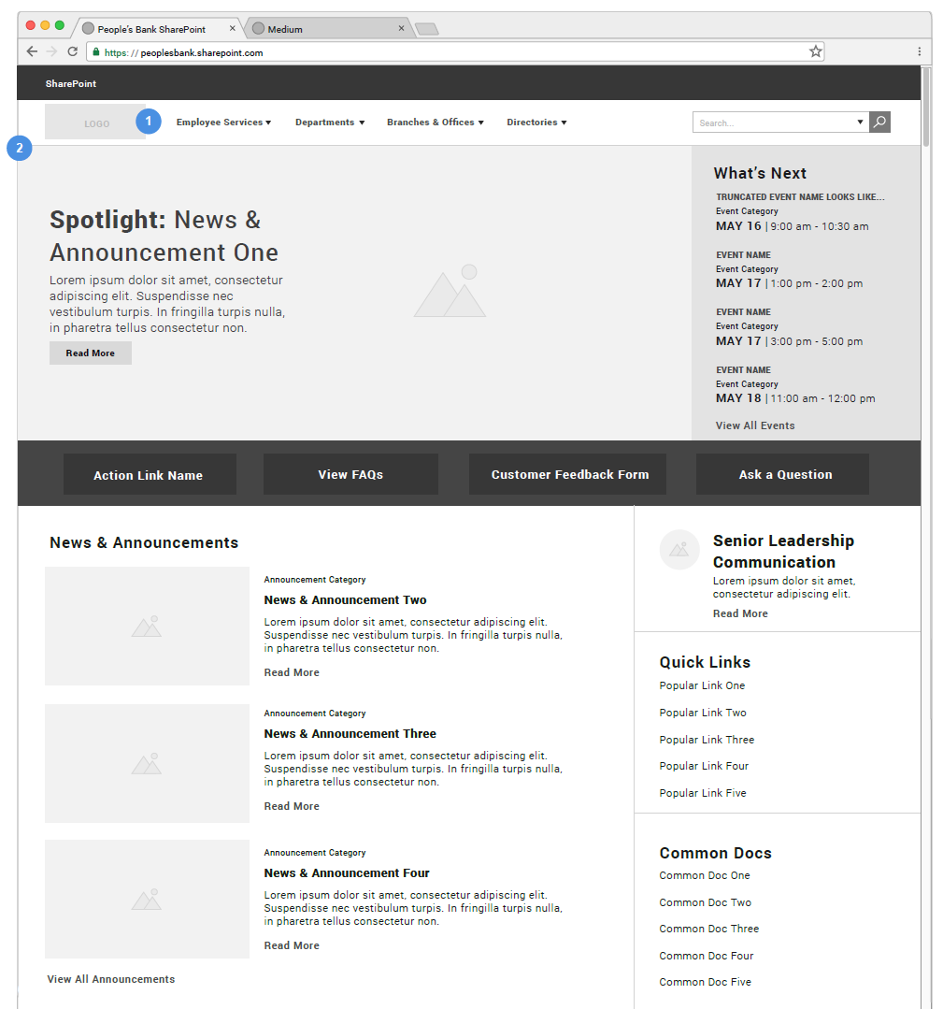
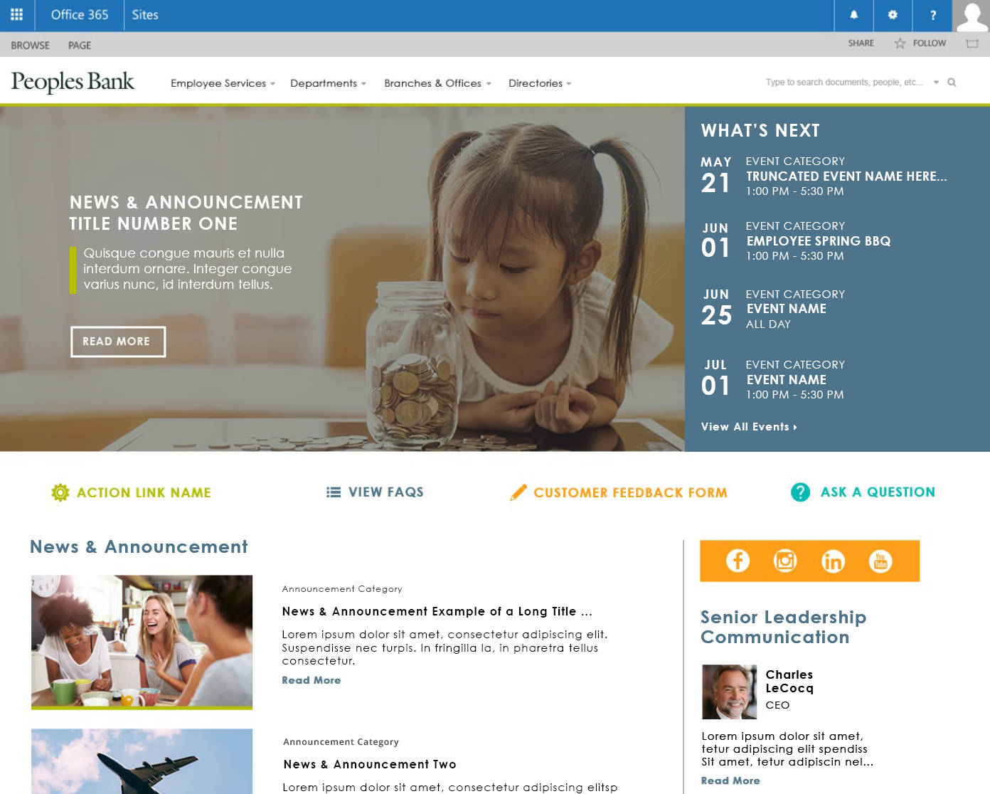
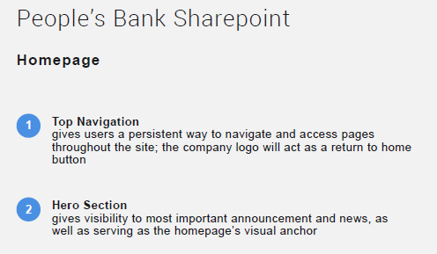
Peoples Bank – Wireframe to Results

Slide 3
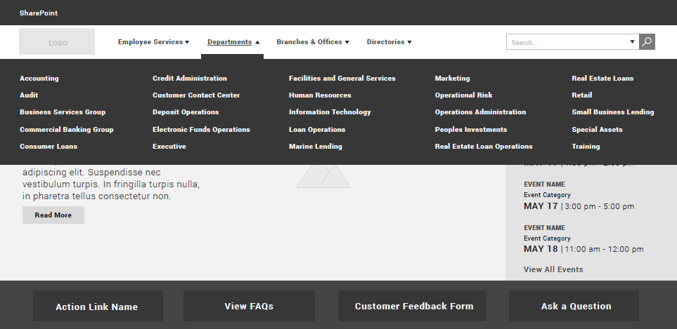
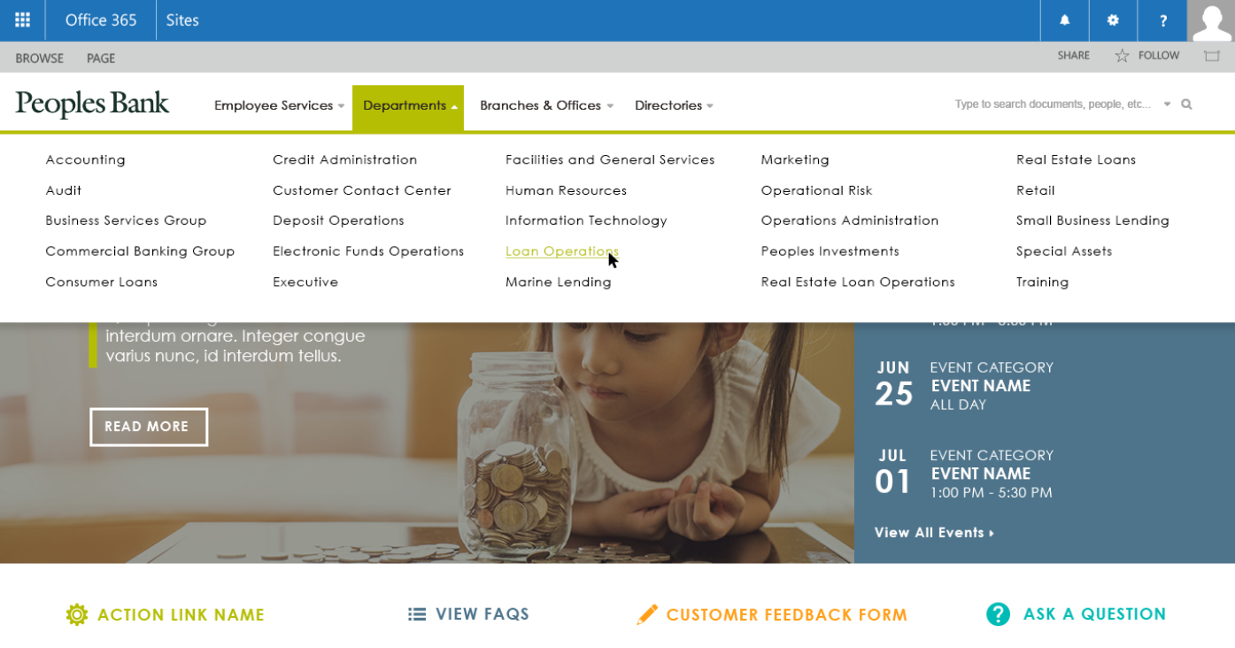
Peoples Bank – Wireframe to Results

Slide 4
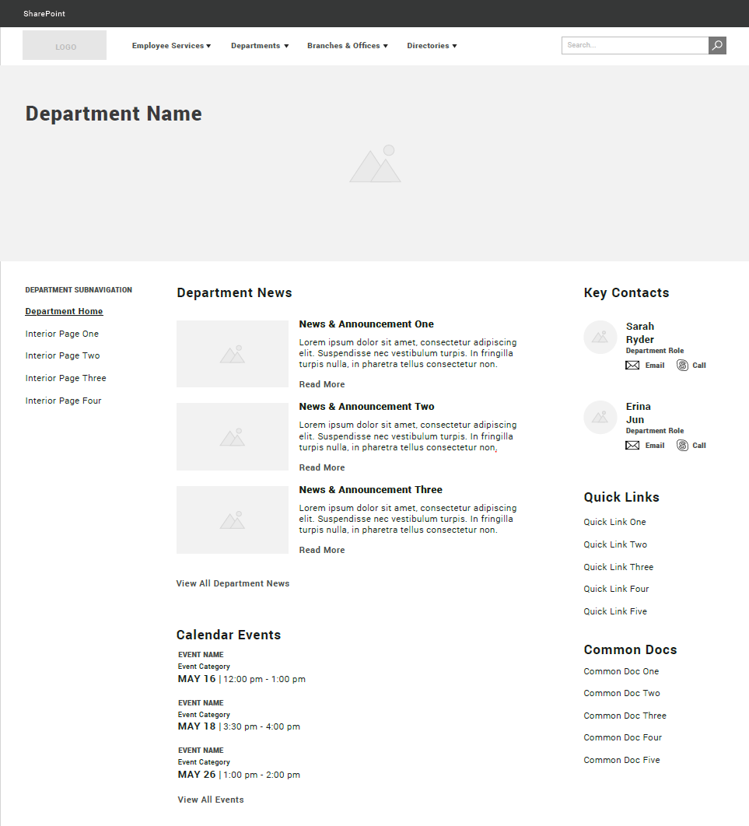
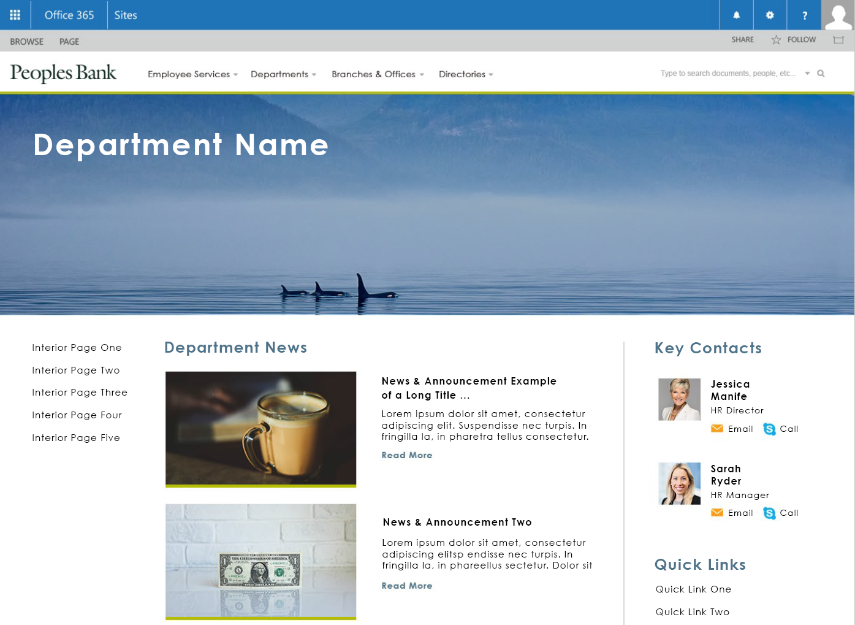
Peoples Bank – Wireframe to Results

